Slide 1

CRICK AI CLUB / 14 SEPTEMBER 2026
Validated skills are
necessary but not sufficient
for trustworthy
agentic genomics
Science after pipelines
Manuel Corpas
Francis Crick Institute
CLAWBIO / TRUSTWORTHY AGENTIC GENOMICS
01
Notes:
SLIDE 1
Title bridge added at the speaker's request on 14 September 2026, followed by original script section 1.
SPOKEN SCRIPT
Good Evening.
I want to start with a deliberately provocative statement.
I think the way we currently do computational science is becoming obsolete.
I don't mean that scientists are becoming obsolete.
I don't mean experiments are obsolete.
And I certainly don't mean that expertise, statistical rigour or biological judgement are obsolete.
I mean something much more specific.
I think the operating model in which humans act as the integration layer between hundreds of computational tools is reaching its end.
END OF SPOKEN SCRIPT
[Sources]
Brand and official logo: https://clawbio.ai/ and https://clawbio.ai/img/clawbio-logo.jpeg (checked 12 September 2026).
Event title: https://luma.com/clawbio-7ibq
[/Sources]

Slide 2

THE COORDINATION PROBLEM
The human
is the API.
Pipelines
›_
Data
Scripts
Literature
›_
Expert attention
becomes glue.
Figures
Database
CLAWBIO / TRUSTWORTHY AGENTIC GENOMICS
02
Notes:
SLIDE 2
Original supplied script section 1. Wording preserved; line breaks may reflect slide boundaries.
SPOKEN SCRIPT
Think about how much of modern computational biology still works.
A scientist reads a paper.
Finds some software.
Installs it.
Finds another package.
Converts a file.
Searches a database.
Copies an identifier.
Writes a script.
Runs a pipeline.
Reads an error.
Searches Stack Overflow.
Changes a parameter.
Runs another program.
Copies the results into R.
Generates a figure.
Then searches the literature to understand what that figure might mean.
We have extraordinarily powerful computational infrastructure.
But the scientist is still manually wiring most of it together.
The human is the API.
And my argument today is that this is not going to remain the dominant way science is performed.
END OF SPOKEN SCRIPT
[Sources]
Brand and official logo: https://clawbio.ai/ and https://clawbio.ai/img/clawbio-logo.jpeg (checked 12 September 2026).
Event title: https://luma.com/clawbio-7ibq
[/Sources]

Slide 3
AUTOMATION IS NOT THE SAME AS ORCHESTRATION
Computation is automated.
Coordination is not.
CAPABILITIES
Compute
Store
Execute
›_
HAND-OFFS
The scientist still connects the work.
CLAWBIO / TRUSTWORTHY AGENTIC GENOMICS
03
Notes:
SLIDE 3
Original supplied script section 2. Wording preserved; line breaks may reflect slide boundaries.
SPOKEN SCRIPT
Over the last few decades, biology has automated almost everything around the scientist.
Sequencing is automated.
Imaging is automated.
Mass spectrometry is automated.
Data storage is automated.
Variant calling is automated.
RNA-seq pipelines are automated.
We have workflow managers.
Containers.
Cloud computing.
Galaxy.
Nextflow.
nf-core.
Thousands upon thousands of specialist computational tools.
And yet something rather strange has happened.
The more tools we created, the more cognitive integration we demanded from the scientist.
Somebody still has to know:
Which tool should I use?
What is the right input?
Which reference genome?
Which parameters?
What should come next?
Did the analysis actually work?
Is this result biologically plausible?
Which database should I query now?
Which paper should I read?
And what should I do if something fails halfway through?
We automated individual pieces of computation.
But we have not automated the process of connecting scientific intent to scientific execution.
That gap is becoming increasingly important.
Because the limiting resource in many computational experiments is no longer CPU.
It is no longer storage.
It may increasingly be human attention.
END OF SPOKEN SCRIPT
[Sources]
Brand and official logo: https://clawbio.ai/ and https://clawbio.ai/img/clawbio-logo.jpeg (checked 12 September 2026).
Event title: https://luma.com/clawbio-7ibq
[/Sources]

Slide 4
THE AGENT IS A NEW INTERFACE
From commands to objectives.
COMMANDS
A
B
C
D
Plan
Act
OBJECTIVE
Goal
Stop or ask when needed
Adapt
Check
CLAWBIO / TRUSTWORTHY AGENTIC GENOMICS
04
Notes:
SLIDE 4
Original supplied script sections 3, 4. Wording preserved; line breaks may reflect slide boundaries.
SPOKEN SCRIPT
Consider something familiar to many people here.
Suppose I have an RNA-seq experiment.
I do not wake up in the morning thinking:
“What I really want today is to run STAR, Salmon, DESeq2 and fgsea.”
That is not the scientific question.
The question might be:
“Why are these tumour cells resistant to treatment?”
Or:
“Which pathways distinguish these two cellular states?”
Between that biological question and the answer sits an enormous translation layer.
The scientist translates biological intent into computational operations.
Choose the data.
Choose the pipeline.
Configure it.
Execute it.
Inspect quality control.
Perform statistics.
Integrate databases.
Read literature.
Interpret the result.
And repeat.
Our software largely waits for us to tell it exactly what command to execute next.
That architecture made sense when computers could calculate but could not reason about our intentions.
But that assumption has changed.
We now have machines that can interpret goals expressed in ordinary language, decompose those goals into subtasks, select tools, inspect results and decide what to do next.
Once that capability exists, making the scientist manually operate every piece of software starts to look increasingly like an historical artefact.
We have seen this transition before in computing.
At first, humans programmed machines using very low-level instructions.
Then we created higher-level languages.
Then operating systems.
Graphical interfaces.
Search engines.
Cloud platforms.
Each abstraction removed another layer of machinery that humans had previously needed to operate manually.
I think agents represent another such abstraction.
Instead of saying:
“Run command A, take output B, transform it into format C, pass it to tool D…”
I can specify the objective:
“Determine which molecular mechanisms distinguish these two conditions, test the strongest explanations, and show me the evidence.”
An agent is not simply a chatbot answering that question.
A scientific agent should be capable of taking a goal and acting.
It can decide which capabilities are required.
Invoke them.
Inspect outputs.
Detect failure.
Try alternatives.
Query external knowledge.
Maintain state across multiple steps.
And stop when predefined success criteria have been satisfied.
That is a fundamentally different interface to computation.
The interface is no longer:
human → command → tool.
It becomes:
scientist → objective → agent → scientific capabilities.
END OF SPOKEN SCRIPT
[Sources]
Brand and official logo: https://clawbio.ai/ and https://clawbio.ai/img/clawbio-logo.jpeg (checked 12 September 2026).
Event title: https://luma.com/clawbio-7ibq
[/Sources]

Slide 5
FUTURE SCENARIO
A different
morning
in the lab.
OVERNIGHT ANALYSIS
SCHEMATIC
What explains the phenotype?
A
Hypothesis
Support
B
Alternative
Conflict
?
Unresolved
Unknown
Less operating.
More investigating.
NEXT: a discriminating experiment
CLAWBIO / TRUSTWORTHY AGENTIC GENOMICS
05
Notes:
SLIDE 5
Original supplied script section 5. Wording preserved; line breaks may reflect slide boundaries.
SPOKEN SCRIPT
Now imagine what this does to the scientific workflow.
You come into the laboratory in the morning.
Instead of opening six portals, three notebooks, GitHub, RStudio, a terminal and PubMed, you begin with the scientific question.
You say:
“We received the sequencing results overnight. Compare them with the previous experiment. Check the quality. Identify unexpected changes. Test whether our original hypothesis still holds. Look for plausible alternative mechanisms and tell me what experiment would discriminate between them.”
The agent begins working.
Not generating a paragraph.
Doing the work.
It invokes validated pipelines.
Checks QC.
Queries databases.
Runs statistical analyses.
Compares results with previous experiments.
Searches supporting evidence.
Produces hypotheses.
And perhaps most importantly, it comes back and says:
“There are three plausible explanations. Here is the evidence for each. Here is what remains uncertain. And here is the next experiment that would distinguish them.”
The scientist has not disappeared.
The scientist has moved up the abstraction hierarchy.
From operating tools...
to directing scientific inquiry.
That is why I think future science will increasingly be performed with and through agents.
END OF SPOKEN SCRIPT
[Sources]
Brand and official logo: https://clawbio.ai/ and https://clawbio.ai/img/clawbio-logo.jpeg (checked 12 September 2026).
Event title: https://luma.com/clawbio-7ibq
[/Sources]

Slide 6
CAPABILITY IS NOT CORRECTNESS
Bad science.
At machine speed.
Unconstrained choices.
Convincing conclusions.
CLAWBIO / TRUSTWORTHY AGENTIC GENOMICS
06
Notes:
SLIDE 6
Original supplied script section 6. Wording preserved; line breaks may reflect slide boundaries.
SPOKEN SCRIPT
And this is where the story becomes much less comfortable.
Because an agent that can perform science can also perform bad science at extraordinary speed.
Large language models are probabilistic systems.
Ask one to construct an RNA-seq pipeline and it may produce something perfectly reasonable.
Ask again and it may make slightly different decisions.
Change model and it may select different methods.
Change one sentence in the request and another analytical choice may change.
Worse still, it may produce an analysis that looks extremely convincing while containing a subtle scientific error.
And biology is full of decisions where subtle errors matter.
So if future science is agentic, the important question is no longer:
“Can AI perform this analysis?”
Increasingly, it can.
The important question becomes:
“How do we allow agents to perform science without allowing them to invent the science as they go along?”
That is the problem ClawBio is trying to address.
END OF SPOKEN SCRIPT
[Sources]
Brand and official logo: https://clawbio.ai/ and https://clawbio.ai/img/clawbio-logo.jpeg (checked 12 September 2026).
Event title: https://luma.com/clawbio-7ibq
[/Sources]

Slide 7
OPEN SCIENTIFIC INFRASTRUCTURE
ClawBio
RNA
A skill library for agentic biology
DNA
Agents reason.
Skills constrain.
Tools compute.
QC
Cells
CLAWBIO / TRUSTWORTHY AGENTIC GENOMICS
07
Notes:
SLIDE 7
Original supplied script section 7. Wording preserved; line breaks may reflect slide boundaries.
SPOKEN SCRIPT
ClawBio is an open-source, bioinformatics-native skill library for AI agents.
But I want to be precise about what that means.
ClawBio is not an attempt to build a better biological chatbot.
And it is not an attempt to replace Galaxy, Nextflow, nf-core, R, Python or the enormous computational ecosystem biology has already created.
It is an attempt to make that ecosystem usable by agents in a controlled way.
The current repository contains 97 skills, 92 of them with runnable demonstration data, more than 4,700 tests, access to more than 8,000 Galaxy tools, and a growing validation and benchmarking infrastructure.
But the numbers are less important than the architecture.
The central idea is extremely simple:
The agent should reason.
The scientific software should compute.
And an explicit specification should constrain the relationship between them.
END OF SPOKEN SCRIPT
[Sources]
Brand and official logo: https://clawbio.ai/ and https://clawbio.ai/img/clawbio-logo.jpeg (checked 12 September 2026).
Event title: https://luma.com/clawbio-7ibq
ClawBio repository README: https://github.com/ClawBio/ClawBio/blob/main/README.md
13 September 2026: 97 skills; 92 runnable demos; 4,824 reported tests; 8,182 Galaxy tools. Reported repository counts, not independently rerun.
[/Sources]

Slide 8
THE ARCHITECTURE
The
missing
layer.
REASONING
Model
SPECIFICATION
SKILL.md
Expertise
lives here.
EXECUTION
Scientific tools
CLAWBIO / TRUSTWORTHY AGENTIC GENOMICS
Source: repository README
08
Notes:
SLIDE 8
Original supplied script section 8. Wording preserved; line breaks may reflect slide boundaries.
SPOKEN SCRIPT
I think of scientific agents as having three layers.
At the top is the reasoning layer.
That might be Claude.
ChatGPT.
A local open model.
Or some future system that does not exist yet.
At the bottom is the execution layer.
Python.
R.
Nextflow.
Galaxy.
nf-core.
Specialist bioinformatics software.
These are the things actually performing the calculations.
But there is a missing layer between them.
The specification layer.
This is where domain expertise belongs.
Which method should be used?
What inputs are acceptable?
What quality-control thresholds matter?
What outputs are required?
What assumptions must be reported?
When should execution stop?
When should the system refuse to give an answer?
In ClawBio, much of this information is encoded in a human-readable specification called SKILL.md.
And this distinction is fundamental.
Instead of hoping the language model remembers the right scientific method from its training data, we give the agent an explicit, versioned scientific contract.
The LLM is not the method.
The LLM is the orchestrator.
The method lives outside the model.
END OF SPOKEN SCRIPT
[Sources]
Brand and official logo: https://clawbio.ai/ and https://clawbio.ai/img/clawbio-logo.jpeg (checked 12 September 2026).
Event title: https://luma.com/clawbio-7ibq
ClawBio repository README: https://github.com/ClawBio/ClawBio/blob/main/README.md
13 September 2026: 97 skills; 92 runnable demos; 4,824 reported tests; 8,182 Galaxy tools. Reported repository counts, not independently rerun.
[/Sources]

Slide 9
A SCIENTIFIC CAPABILITY, PACKAGED
An executable methods section.
SKILL.md
›_
Specification
Code
v1.0
Demo data
Tests + provenance
CLAWBIO / TRUSTWORTHY AGENTIC GENOMICS
Source: repository README
09
Notes:
SLIDE 9
Original supplied script section 9. Wording preserved; line breaks may reflect slide boundaries.
SPOKEN SCRIPT
So what actually is one of these skills?
For someone who does not write software, I would describe it as:
an executable methods section.
A skill contains the instructions an agent needs to know when and how an analysis should be performed.
It contains executable software.
It can contain demonstration data.
It can contain tests.
And it can generate provenance and reproducibility information.
For the computational scientists in the room, you can think of it as a versioned contract around deterministic analytical software.
And there is a very important philosophical difference here.
If the scientific knowledge exists only inside a foundation model, then it is difficult to inspect, difficult to version and difficult to peer review.
If the scientific decisions live in a specification, we can open it.
Read it.
Criticise it.
Test it.
Version it.
Compare alternatives.
And improve it.
In other words:
scientific expertise becomes infrastructure.
END OF SPOKEN SCRIPT
[Sources]
Brand and official logo: https://clawbio.ai/ and https://clawbio.ai/img/clawbio-logo.jpeg (checked 12 September 2026).
Event title: https://luma.com/clawbio-7ibq
ClawBio repository README: https://github.com/ClawBio/ClawBio/blob/main/README.md
13 September 2026: 97 skills; 92 runnable demos; 4,824 reported tests; 8,182 Galaxy tools. Reported repository counts, not independently rerun.
[/Sources]

Slide 10
CURRENT REPOSITORY SNAPSHOT
An ecosystem.
Not another pipeline.
97
scientific skills
Genomes
RNA
Cells
92
runnable demos
Traits
Proteins
Microbes
8,182
Galaxy tools
Catalogue breadth ≠ uniform validation
CLAWBIO / TRUSTWORTHY AGENTIC GENOMICS
README snapshot · 13 SEP 2026
10
Notes:
SLIDE 10
Original supplied script section 10. Wording preserved; line breaks may reflect slide boundaries.
SPOKEN SCRIPT
The repository already spans a fairly broad slice of bioinformatics.
Pharmacogenomics.
Polygenic risk.
Ancestry analysis.
GWAS interrogation.
Fine mapping.
Variant annotation.
Clinical variant interpretation.
UK Biobank navigation.
Bulk RNA-seq.
Single-cell RNA-seq.
Methylation.
Proteomics.
Metagenomics.
And through the Galaxy Bridge, thousands of existing Galaxy tools become discoverable and potentially composable by agents.
There are wrappers around established nf-core workflows, including RNA-seq, single-cell preprocessing and Sarek.
That last point matters.
The aim is not to rewrite bioinformatics using AI.
That would be a terrible waste of decades of community effort.
The aim is to make the tools we already trust agent-addressable.
The intelligence moves into orchestration.
The computation remains in scientific software.
END OF SPOKEN SCRIPT
[Sources]
Brand and official logo: https://clawbio.ai/ and https://clawbio.ai/img/clawbio-logo.jpeg (checked 12 September 2026).
Event title: https://luma.com/clawbio-7ibq
ClawBio repository README: https://github.com/ClawBio/ClawBio/blob/main/README.md
13 September 2026: 97 skills; 92 runnable demos; 4,824 reported tests; 8,182 Galaxy tools. Reported repository counts, not independently rerun.
[/Sources]

Slide 11
CRICK USE CASE · PROPOSED COMPOSITION
From RNA reads
to a biological question.
Why does the perturbation
rescue the phenotype?
EXISTING UPSTREAM CAPABILITY
PROPOSED DOWNSTREAM COMPOSITION
›_
FASTQ
nf-core
Counts
Compare
Hypotheses
Preflight + QC
STOP
Human judgement stays in the loop.
CLAWBIO / TRUSTWORTHY AGENTIC GENOMICS
Sources: RNA-seq wrapper; README
11
Notes:
SLIDE 11
Original supplied script section 11. Wording preserved; line breaks may reflect slide boundaries.
SPOKEN SCRIPT
Let's make this more concrete.
Imagine an RNA experiment happening here at the Crick.
You have FASTQ files.
Your question is not:
“How do I configure nf-core/rnaseq?”
Your question is biological.
Perhaps:
“Why does this perturbation rescue the phenotype?”
The agent receives that objective.
It recognises that the raw sequencing data first require processing.
It invokes a validated RNA-seq workflow.
It checks whether the sequencing quality is acceptable.
It obtains the count matrix.
Another capability performs differential expression.
Another performs pathway-level analysis.
Perhaps another interrogates previous studies.
The agent examines the outputs and asks:
Does the evidence support our original mechanism?
Are there contradictory signals?
Is the effect driven by one outlier?
Do the pathways suggest an alternative explanation?
Maybe it then proposes:
“The strongest unexpected signal is interferon response. I found two competing explanations. These three perturbations would discriminate between them.”
Now we have moved beyond pipeline automation.
The pipeline was only one step.
The agent is operating across the scientific reasoning-execution loop.
That, for me, is where things become transformative.
END OF SPOKEN SCRIPT
[Sources]
Brand and official logo: https://clawbio.ai/ and https://clawbio.ai/img/clawbio-logo.jpeg (checked 12 September 2026).
Event title: https://luma.com/clawbio-7ibq
ClawBio repository README: https://github.com/ClawBio/ClawBio/blob/main/README.md
13 September 2026: 97 skills; 92 runnable demos; 4,824 reported tests; 8,182 Galaxy tools. Reported repository counts, not independently rerun.
RNA workflow example is a proposed composition, not a claim of demonstrated end-to-end execution.
[/Sources]

Slide 12
REPRODUCIBILITY BY DESIGN
Every answer needs
an evidence trail.
Inputs
EVIDENCE
What ran
Method
What changed
›_
Execution
What failed
Outputs
Replayable ≠ scientifically valid
CLAWBIO / TRUSTWORTHY AGENTIC GENOMICS
Source: repository README
12
Notes:
SLIDE 12
Original supplied script section 12. Wording preserved; line breaks may reflect slide boundaries.
SPOKEN SCRIPT
But the more autonomous that system becomes, the more important trust becomes.
A chatbot can give us an interesting suggestion.
A scientific agent needs to leave evidence.
Which tools did you use?
Which version?
What data?
Which parameters?
Why did you choose that method?
What failed?
What changed?
Can I reproduce the output?
What happens if I execute the same analysis tomorrow?
Many ClawBio skills therefore produce reproducibility bundles containing things such as replay commands, environment information and cryptographic checksums.
END OF SPOKEN SCRIPT
[Sources]
Brand and official logo: https://clawbio.ai/ and https://clawbio.ai/img/clawbio-logo.jpeg (checked 12 September 2026).
Event title: https://luma.com/clawbio-7ibq
ClawBio repository README: https://github.com/ClawBio/ClawBio/blob/main/README.md
13 September 2026: 97 skills; 92 runnable demos; 4,824 reported tests; 8,182 Galaxy tools. Reported repository counts, not independently rerun.
[/Sources]

Slide 13
BENCHMARKING, NOT PERSUASION
Trust is measured.
161
/ 182
reported checks passing
10 audited skills
Not clinical accuracy.
Not every skill.
161 passing
21 remainder
CLAWBIO / TRUSTWORTHY AGENTIC GENOMICS
README snapshot · 12 SEP 2026
13
Notes:
SLIDE 13
Original supplied script section 12. Wording preserved; line breaks may reflect slide boundaries.
SPOKEN SCRIPT
But reproducibility is only one dimension.
We also need validation.
The repository now contains systematic benchmark infrastructure.
Known ground truth.
Negative controls.
Deterministic mock APIs.
Precision.
Recall.
F1.
Comparisons between alternative algorithms.
The current public benchmark reports 161 of 182 tests passing across ten audited skills.
And I actually think the failures are as important as the successes.
Because a trustworthy scientific system should expose where it fails.
The objective should never be:
“Make the agent look intelligent.”
It should be:
“Measure whether the agentic system recovers the scientifically correct result, and characterise where it does not.”
That shift is essential.
END OF SPOKEN SCRIPT
[Sources]
Brand and official logo: https://clawbio.ai/ and https://clawbio.ai/img/clawbio-logo.jpeg (checked 12 September 2026).
Event title: https://luma.com/clawbio-7ibq
ClawBio repository README: https://github.com/ClawBio/ClawBio/blob/main/README.md
13 September 2026: 97 skills; 92 runnable demos; 4,824 reported tests; 8,182 Galaxy tools. Reported repository counts, not independently rerun.
[/Sources]

Slide 14
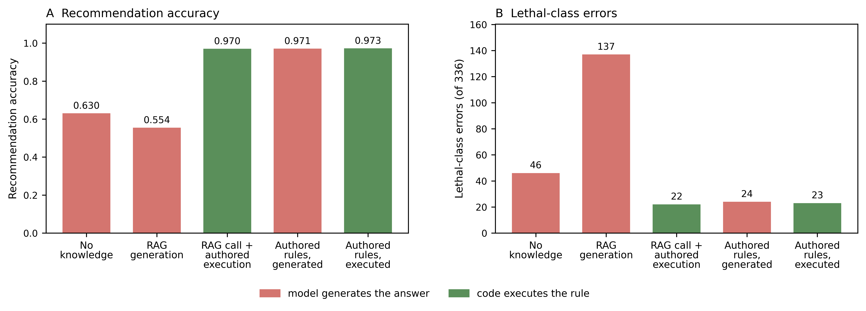
PHARMACOGENOMICS / A CONTROLLED TEST
Validated rules change the result.
CLAWBIO / TRUSTWORTHY AGENTIC GENOMICS
Source: manuscript v90, Figure 2
14
Notes:
SPOKEN SCRIPT
So what happens when we test this in pharmacogenomics?
We asked eight models to interpret one hundred and ten cases.
The question was simple.
Does giving the agent validated rules improve its recommendations?
Look at the left-hand panel.
Without additional knowledge, accuracy was about sixty-three percent.
With retrieved guideline prose, about fifty-five percent.
With validated rules, about ninety-seven percent.
The big improvement came from the rules.
Having the model read them and executing them in code gave similar accuracy.
But code made the mapping deterministic.
The same input produced the same decision.
Now look at the right-hand panel.
These are errors on our highest-severity test cases.
Those counts depend on the wording accepted by the scorer.
They are not measurements of patient harm.
So we have improved one part of the process.
But what if the input to that process is wrong?
END OF SPOKEN SCRIPT
[Sources]
Manuscript v90, Figure 2, 00-CURRENT/FIGURES/Figure2.tiff. Supplied by the author. Figure reproduced unchanged. RAG bar label is 0.554 in supplied artwork; manuscript Table 1 reports 55.5%. Spoken script uses about 55%. High-severity counts use the original wording-dependent scorer.
Data and provenance: https://doi.org/10.5281/zenodo.22141182
[/Sources]

Slide 15
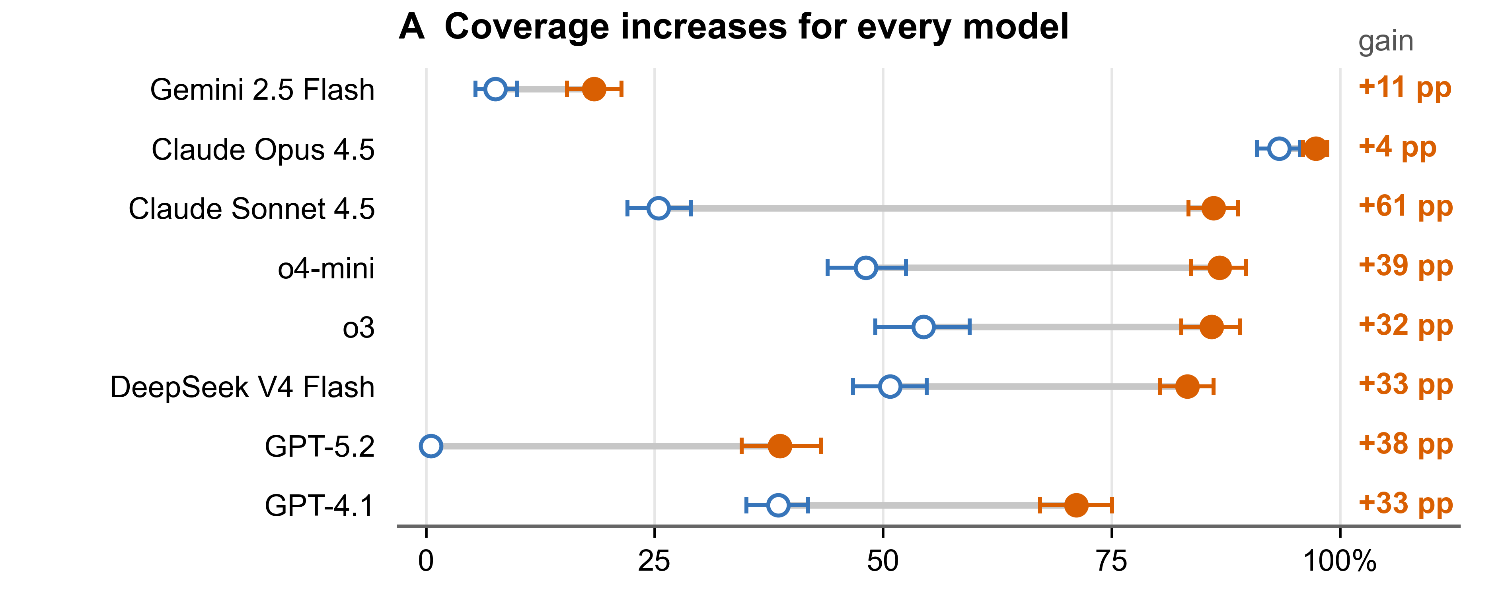
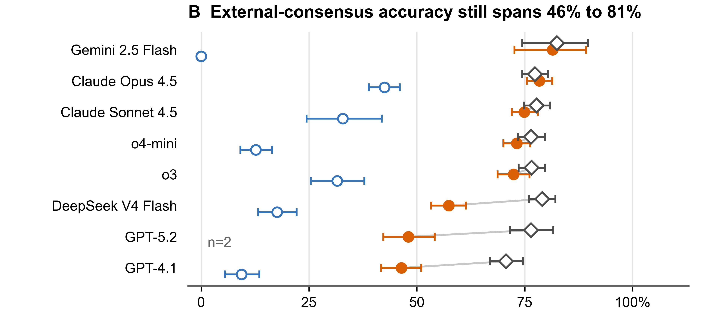
PHARMACOGENOMICS / THE REMAINING BOUNDARY
The input still needs validation.
CLAWBIO / TRUSTWORTHY AGENTIC GENOMICS
Source: manuscript v90, Figure 4
15
Notes:
SPOKEN SCRIPT
That brings us to the second figure.
Before applying a rule, the system has to interpret the genetic input.
We tested that step on five hundred and twenty-seven sample-gene pairs with an external reference.
Blue means the model had no allele definitions.
Orange means we supplied validated definitions.
On the left, more inputs receive an answer.
That is useful.
But answering more often is not the same as answering correctly.
On the right, accuracy still varies substantially between models.
Even with the definitions, it ranges from about forty-six to eighty-one percent among the calls they make.
And the models do not all answer the same number of cases.
So we need to examine accuracy and coverage together.
A validated skill can make one step dependable.
It cannot make a wrong input right.
That is why the title says necessary, but not sufficient.
And as we connect skills together, every handoff needs evidence.
END OF SPOKEN SCRIPT
[Sources]
Manuscript v90, Figure 4, 00-CURRENT/FIGURES/Figure4.tiff. Supplied by the author. Figure panels rearranged side by side; plotted content unchanged.
Data and provenance: https://doi.org/10.5281/zenodo.22141182
[/Sources]

Slide 16
COMPOSE. DO NOT REPLACE.
Build on the tools
we already trust.
AGENT
VERSIONED SKILLS
Galaxy
nf-core
Python / R
Lab pipelines
CLAWBIO / TRUSTWORTHY AGENTIC GENOMICS
Source: README; extension model is conceptual
16
Notes:
SLIDE 16
Original supplied script section 13. Wording preserved; line breaks may reflect slide boundaries.
SPOKEN SCRIPT
There is another important consequence of skills.
They become composable.
One skill can process sequencing.
Another can annotate variants.
Another can interrogate population frequency.
Another can examine pharmacogenomic consequences.
Another can search literature.
Another can test a statistical hypothesis.
An agent can connect them because their capabilities are explicitly described.
And suddenly something interesting happens.
Galaxy becomes agent infrastructure.
nf-core becomes agent infrastructure.
Bioconductor becomes agent infrastructure.
Institutional workflows become agent infrastructure.
Perhaps your laboratory's own carefully validated pipeline becomes agent infrastructure.
We do not need one enormous AI system that knows how to perform all of biology.
We need an ecosystem of small, inspectable, specialised scientific capabilities that agents can compose.
That is much closer to how science itself works.
Nobody in this building knows everything.
Science scales through specialisation and collaboration.
Agentic science can work the same way.
END OF SPOKEN SCRIPT
[Sources]
Brand and official logo: https://clawbio.ai/ and https://clawbio.ai/img/clawbio-logo.jpeg (checked 12 September 2026).
Event title: https://luma.com/clawbio-7ibq
ClawBio repository README: https://github.com/ClawBio/ClawBio/blob/main/README.md
13 September 2026: 97 skills; 92 runnable demos; 4,824 reported tests; 8,182 Galaxy tools. Reported repository counts, not independently rerun.
[/Sources]

Slide 17
FUTURE PUBLISHING MODEL
Publish methods that can execute.
Replay
PAPER
›_
Reuse
Figure 3
SKILL
Challenge
A paper becomes an interface.
CLAWBIO / TRUSTWORTHY AGENTIC GENOMICS
Publishing vision inspired by the README
17
Notes:
SLIDE 17
Original supplied script section 14. Wording preserved; line breaks may reflect slide boundaries.
SPOKEN SCRIPT
And now return to the scientific paper.
Today, we publish a paper.
Perhaps some supplementary material.
Maybe some code.
If we're good, containers and workflows.
But imagine a paper publishing something additional:
the scientific skill.
Another laboratory reads the paper and says:
“Reproduce Figure 3.”
The agent finds the corresponding skill.
Obtains the appropriate data.
Executes the validated implementation.
Checks the outputs.
Compares them with the expected results.
Reports what reproduced and what did not.
Then the laboratory asks:
“Apply exactly the same analytical procedure to our dataset.”
And it does.
Now the paper is no longer only prose describing what happened.
Part of the scientific contribution becomes machine-executable knowledge.
And that creates another possibility.
An agent could read thousands of papers where the methods are executable.
Re-run analyses.
Compare methods.
Find contradictions.
Test whether conclusions generalise across datasets.
Suggest experiments that resolve disagreement.
At that point, agents are no longer merely helping us use scientific knowledge.
They become participants in the machinery by which scientific knowledge is tested and extended.
END OF SPOKEN SCRIPT
[Sources]
Brand and official logo: https://clawbio.ai/ and https://clawbio.ai/img/clawbio-logo.jpeg (checked 12 September 2026).
Event title: https://luma.com/clawbio-7ibq
ClawBio repository README: https://github.com/ClawBio/ClawBio/blob/main/README.md
13 September 2026: 97 skills; 92 runnable demos; 4,824 reported tests; 8,182 Galaxy tools. Reported repository counts, not independently rerun.
[/Sources]

Slide 18
THE SCIENTIST MOVES UP THE ABSTRACTION HIERARCHY
From operator
to scientific director.
Judgement
›_
CLAWBIO / TRUSTWORTHY AGENTIC GENOMICS
18
Notes:
SLIDE 18
Original supplied script section 15. Wording preserved; line breaks may reflect slide boundaries.
SPOKEN SCRIPT
So let me finish where I started.
I believe the dominant human-operated model of computational science is becoming obsolete.
Not because scientists are unnecessary.
Exactly the opposite.
Our scientific judgement is too valuable to spend so much of it manually operating computational machinery.
The transition I expect is:
from commands to objectives.
From applications to capabilities.
From static workflows to agents.
From papers that describe computation to scientific objects that can execute.
But there is a choice about how we build that future.
We can create scientific agents that generate plausible analyses from whatever happens to be inside a foundation model.
Or we can build agents whose behaviour is constrained by explicit methods, validated implementations, provenance, benchmarks and community scrutiny.
That second future is what we are trying to build with ClawBio.
END OF SPOKEN SCRIPT
[Sources]
Brand and official logo: https://clawbio.ai/ and https://clawbio.ai/img/clawbio-logo.jpeg (checked 12 September 2026).
Event title: https://luma.com/clawbio-7ibq
ClawBio repository README: https://github.com/ClawBio/ClawBio/blob/main/README.md
13 September 2026: 97 skills; 92 runnable demos; 4,824 reported tests; 8,182 Galaxy tools. Reported repository counts, not independently rerun.
[/Sources]

Slide 19
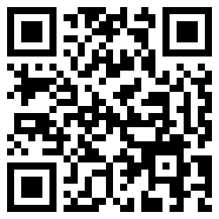
BUILD THE FUTURE OF SCIENTIFIC WORK
What would you
trust an agent
to do?
Which task?
What evidence?
github.com/ClawBio/ClawBio
CLAWBIO / TRUSTWORTHY AGENTIC GENOMICS
19
Notes:
SLIDE 19
Original supplied script section 15. Wording preserved; line breaks may reflect slide boundaries.
SPOKEN SCRIPT
So I want to leave the Crick with two questions.
First:
Which parts of the science you perform today should an agent be doing for you?
And then the much harder question:
What evidence would you require before you trusted an agent to do them?
Because I think that is the challenge immediately ahead of us.
Not whether science becomes agentic.
But what kind of agentic science we choose to build.
END OF SPOKEN SCRIPT
[Sources]
Brand and official logo: https://clawbio.ai/ and https://clawbio.ai/img/clawbio-logo.jpeg (checked 12 September 2026).
Event title: https://luma.com/clawbio-7ibq
ClawBio repository README: https://github.com/ClawBio/ClawBio/blob/main/README.md
13 September 2026: 97 skills; 92 runnable demos; 4,824 reported tests; 8,182 Galaxy tools. Reported repository counts, not independently rerun.
[/Sources]

Slide 20
CONTINUE WITH CLAWBIO
Try a skill. Share what you learn.
01
Read the documentation and run a demo
docs.clawbio.ai
02
Follow the calendar for workshops and hackathons
luma.com/clawbio
03
Join the conversation in ClawBio Slack
Open the ClawBio Slack channel
Choose one analysis. Define the evidence you would require.
clawbio.ai
CLAWBIO / TRUSTWORTHY AGENTIC GENOMICS
20
Notes:
SLIDE 20
Additional slide narration.
SPOKEN SCRIPT
If you would like to follow up, there are three places to start. The documentation is at docs dot clawbio dot A I. Start with a demonstration, inspect the outputs and read the skill specification.
The ClawBio calendar is at Luma dot com slash ClawBio. Follow it for workshops, hackathons and future events.
Join the ClawBio Slack channel linked on this slide. Use it to discuss a task, share a failure case or compare what evidence you would require before using a skill. The same link is in the podcast notes.
Choose one analysis. Define one meaningful test. Then decide what the evidence lets you delegate.
Thank you.
END OF SPOKEN SCRIPT
[Sources]
Brand and official logo: https://clawbio.ai/ and https://clawbio.ai/img/clawbio-logo.jpeg (checked 12 September 2026).
Event title: https://luma.com/clawbio-7ibq
ClawBio repository README: https://github.com/ClawBio/ClawBio/blob/main/README.md
13 September 2026: 97 skills; 92 runnable demos; 4,824 reported tests; 8,182 Galaxy tools. Reported repository counts, not independently rerun.
https://docs.clawbio.ai/
https://luma.com/clawbio
https://app.slack.com/client/T0BP97N69KM/C0BP1FSGTHV
Slack destination supplied directly by Manuel Corpas on 13 September 2026.
[/Sources]

Slide 21
DEPLOYMENT REQUIREMENTS
Autonomy needs boundaries.
Scope
Data
AGENT
Stop / ask
Budget
Approval
Local-first ≠ offline
CLAWBIO / TRUSTWORTHY AGENTIC GENOMICS
Source: data-handling.md; proposed controls
21
Notes:
SLIDE 21
Unspoken reference. Skip during delivery.
SPOKEN SCRIPT
END OF SPOKEN SCRIPT
[Sources]
Brand and official logo: https://clawbio.ai/ and https://clawbio.ai/img/clawbio-logo.jpeg (checked 12 September 2026).
Event title: https://luma.com/clawbio-7ibq
ClawBio repository README: https://github.com/ClawBio/ClawBio/blob/main/README.md
13 September 2026: 97 skills; 92 runnable demos; 4,824 reported tests; 8,182 Galaxy tools. Reported repository counts, not independently rerun.
https://github.com/ClawBio/ClawBio/blob/main/docs/data-handling.md
Reference only: deployment requirements include proposed safeguards.
[/Sources]

Slide 22
SOURCE APPENDIX
Sources & scope
01
Current capabilities + reported counts
README.md
02
Pharmacogenomics: manuscript v90 + release v2.10
doi.org/10.5281/zenodo.22141182
03
Declared data destinations + network behaviour
docs/data-handling.md
Sources checked 12-13 September 2026. Repository counts were not independently rerun.
Component benchmark; no claim of end-to-end clinical validation.
CLAWBIO / TRUSTWORTHY AGENTIC GENOMICS
22
Notes:
SLIDE 22
Unspoken reference. Skip during delivery.
SPOKEN SCRIPT
END OF SPOKEN SCRIPT
[Sources]
Brand and official logo: https://clawbio.ai/ and https://clawbio.ai/img/clawbio-logo.jpeg (checked 12 September 2026).
Event title: https://luma.com/clawbio-7ibq
ClawBio repository README: https://github.com/ClawBio/ClawBio/blob/main/README.md
13 September 2026: 97 skills; 92 runnable demos; 4,824 reported tests; 8,182 Galaxy tools. Reported repository counts, not independently rerun.
Manuscript v90 and Supplementary v48, 31 August 2026, supplied 00-CURRENT directory.
https://doi.org/10.5281/zenodo.22141182
https://github.com/manuelcorpas/24-AGENTIC-PGX-BENCHMARK/tree/agentic-pgx-benchmark-v2.10
Source data: data/v4_flash_five_cell_report.txt. A2 recommendation accuracy; missing attempts count as failures. 110 cases x 8 models x 3 replicates x 5 configurations. Component benchmark; no end-to-end clinical validation claim. No new benchmark execution for this talk.
[/Sources]

